Slide 1
Week 11/12 Charts
DSC640
Shaquiel Pashtunyar

Slide 2
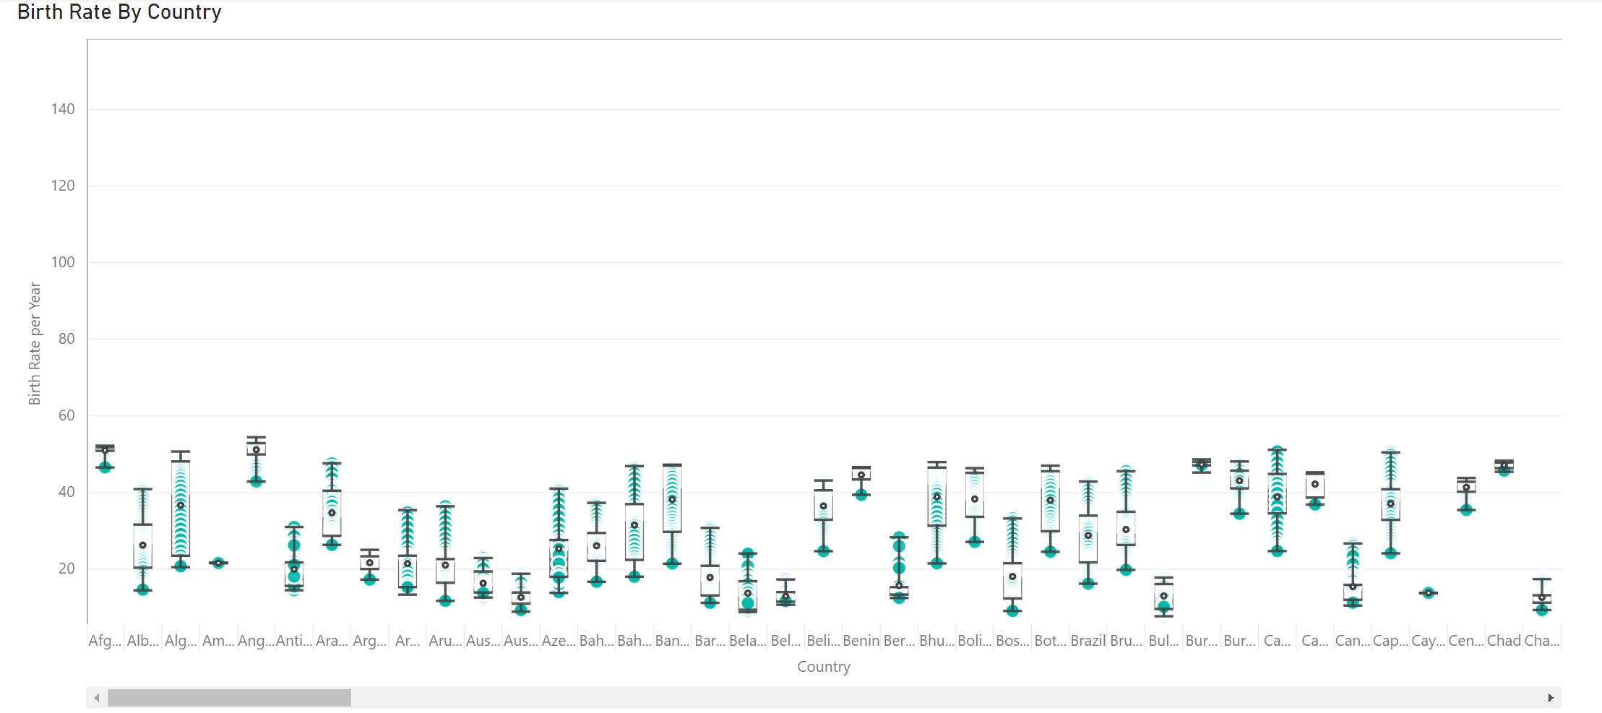
Power BI Box Plot
Is scrollable to see the spread of every country

Slide 3
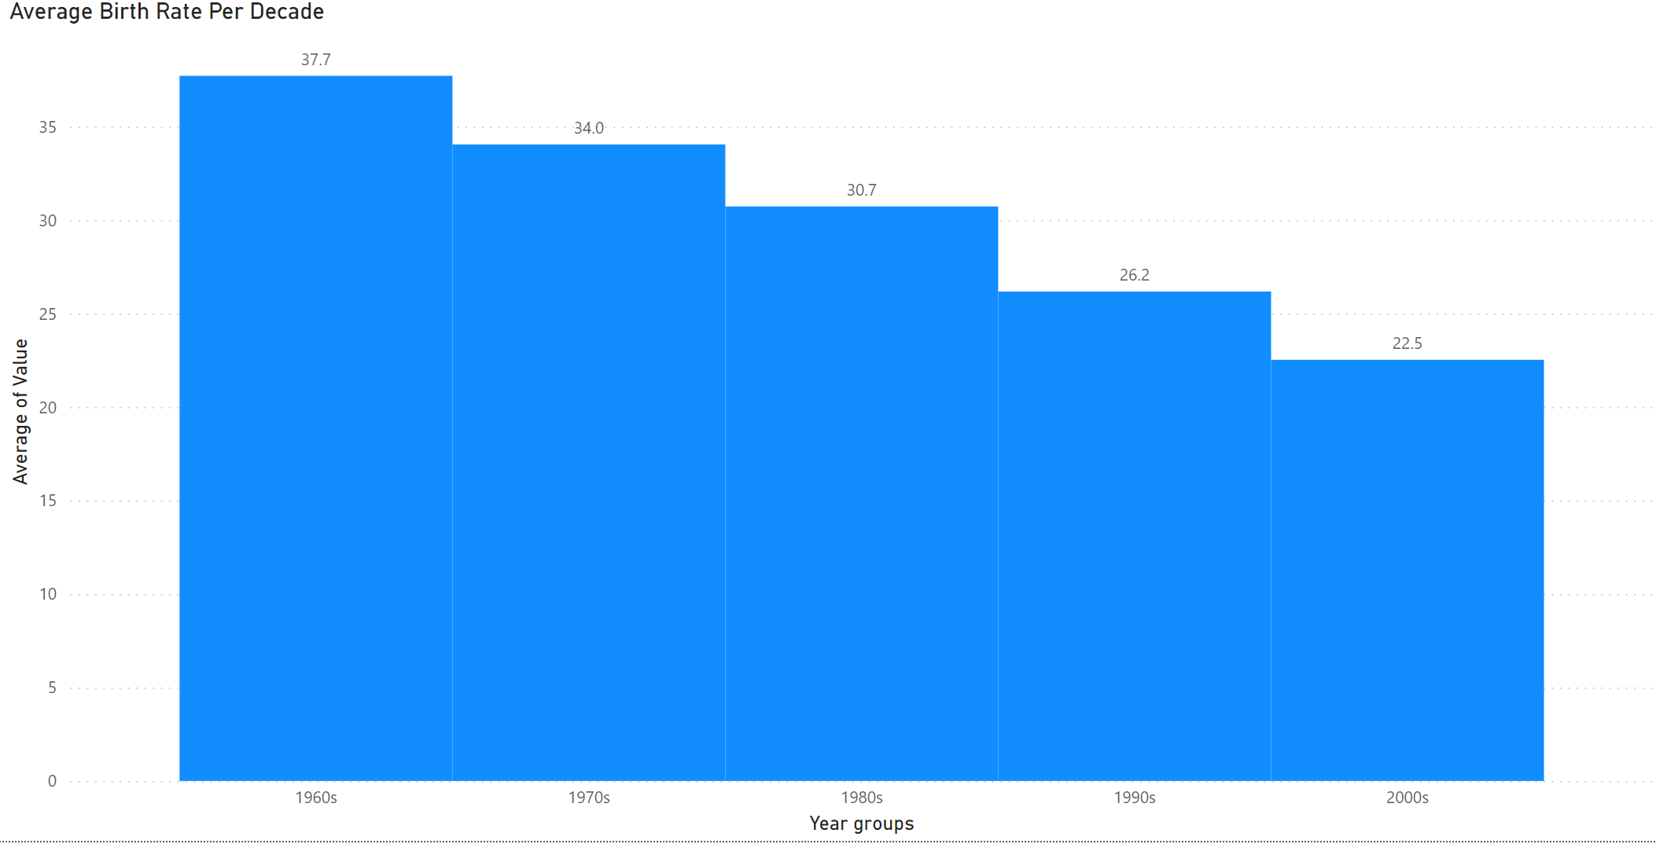
Power BI Histogram

Slide 4
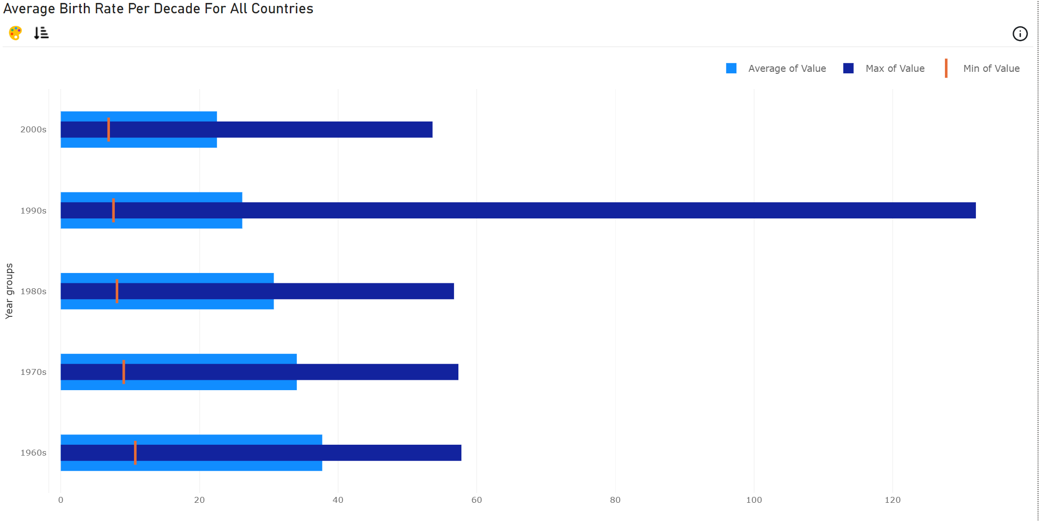
Power BI Bullet Chart

Slide 5
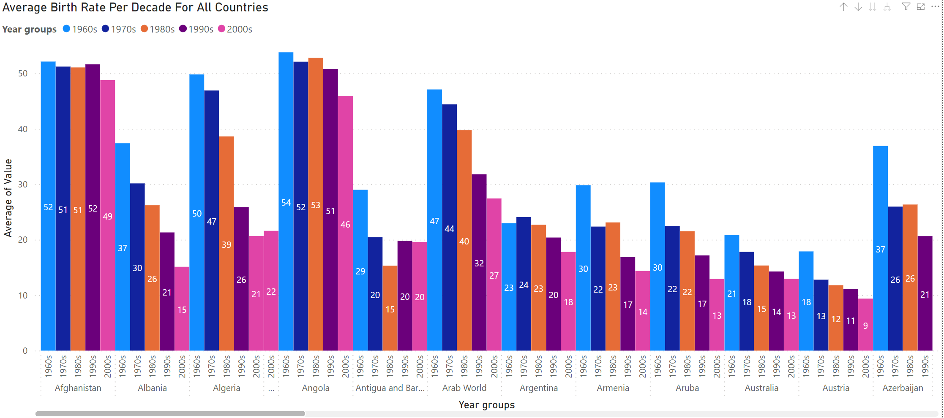
Power BI Group Column Chart

Slide 6
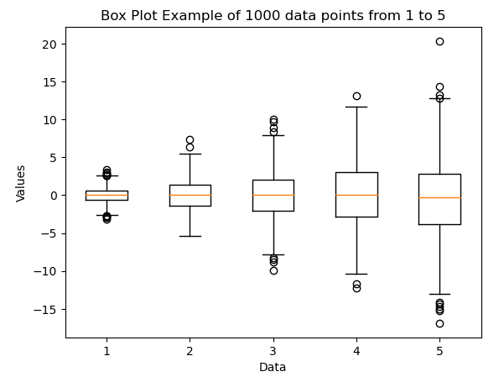
Python Box Plot
data = [np.random.normal(0, std, 1000) for std in range(1, 6)]
fig, ax = plt.subplots()
ax.boxplot(data)
ax.set_xlabel('Data')
ax.set_ylabel('Values')
ax.set_title('Box Plot Example of 1000 data points from 1 to 5')
plt.show()

Slide 7
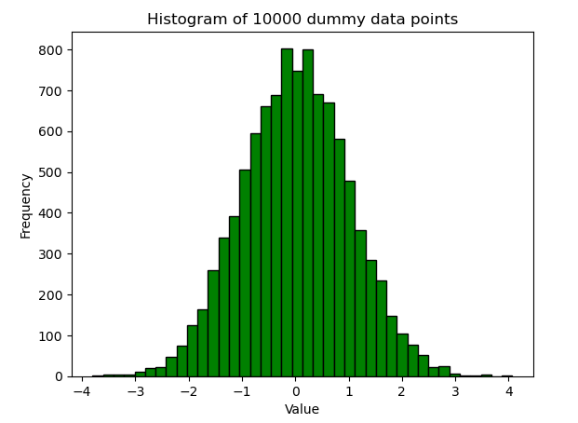
Python Histogram
np.random.seed(123)
data = np.random.normal(0, 1, 10000)
plt.hist(data, bins=40, color='Green', edgecolor='black')
plt.xlabel('Value')
plt.ylabel('Frequency')
plt.title('Histogram of 10000 dummy data points')
plt.show()

Slide 8
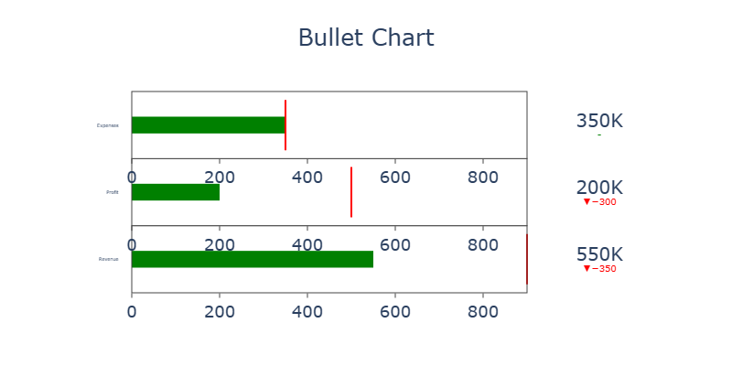
Python Bullet Chart
actual = [550, 200, 350]
target = [900, 500, 350]
categories = ['Revenue', 'Profit', 'Expenses']
fig = go.Figure()
for i in range(len(categories)):
fig.add_trace(go.Indicator(
mode = "number+gauge+delta",
gauge = {'shape': "bullet",
'axis': {'range': [None, max(target)]},
'threshold': {'line': {'color': "red", 'width': 2}, 'thickness': 0.75, 'value': target[i]}},
value = actual[i],
delta = {'reference': target[i], 'increasing': {'color': "green"}, 'decreasing': {'color': "red"}},
number = {'suffix': "K", 'font': {'size': 20}},
title = {'text': categories[i]},
domain = {'x': [0.1, 1], 'y': [i/3, (i+1)/3]}))
fig.update_layout(title_text='Bullet Chart', title_x=0.5,
font=dict(size=18), height=400, width=800)
fig.show()

Slide 9
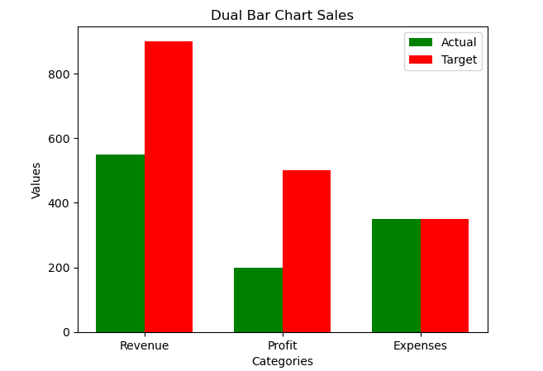
Python Dual Bar Chart
x = np.arange(len(categories))
width = 0.35
fig, ax = plt.subplots()
rects1 = ax.bar(x - width/2, actual, width, label='Actual', color='green')
rects2 = ax.bar(x + width/2, target, width, label='Target', color='red')
ax.set_xlabel('Categories')
ax.set_ylabel('Values')
ax.set_title('Dual Bar Chart Sales')
ax.set_xticks(x)
ax.set_xticklabels(categories)
ax.legend()

Slide 10
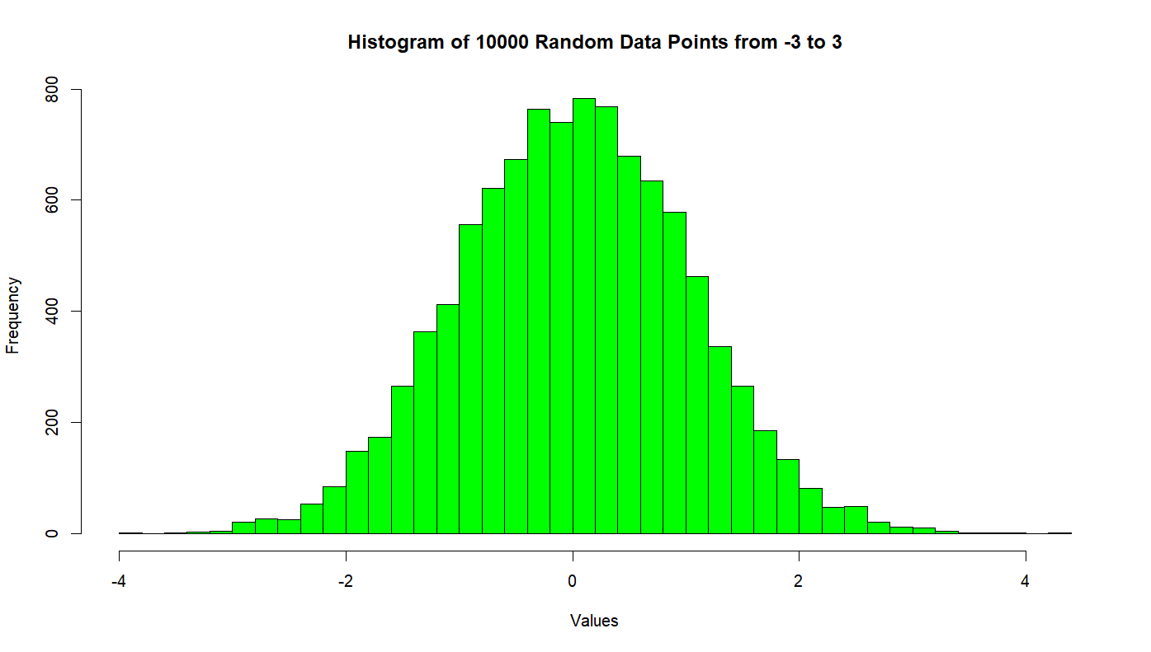
R Histogram
data <- rnorm(10000)
hist(data, breaks = 30, col = "Green", border = "black", xlab = "Values", ylab = "Frequency", main = "Histogram of 10000 Random Data Points from -3 to 3")

Slide 11
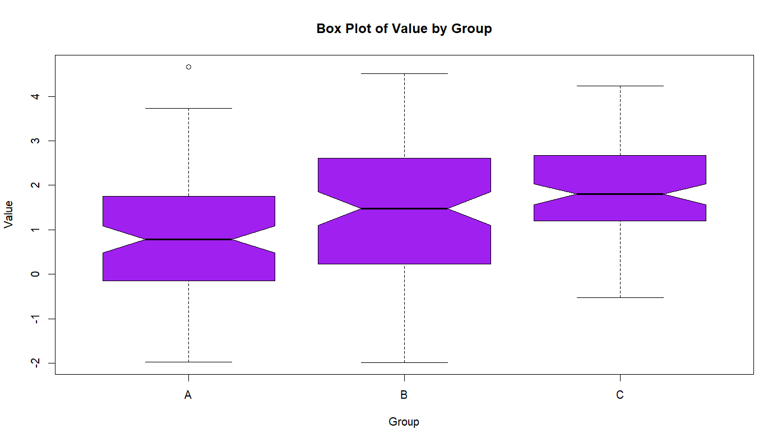
R Box Plot
set.seed(123)data <- data.frame( Group = rep(c("A", "B", "C"), each = 50), Value = c(rnorm(100), rnorm(100, mean = 1.5), rnorm(100, mean = 2.5)))
boxplot(Value ~ Group, data = data, main = "Box Plot of Value by Group", xlab = "Group", ylab = "Value", col = "Purple", border = "black", notch = TRUE, notch.frac = 0.5)

Slide 12
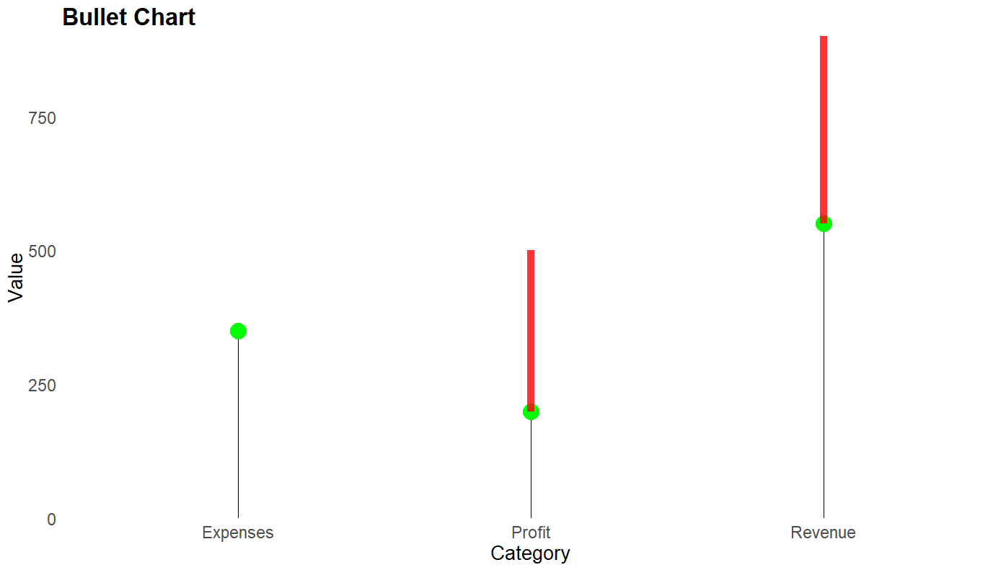
R Bullet Chart
set.seed(123)data <- data.frame( Category = c("Revenue", "Profit", "Expenses"), Actual = c(550, 200, 350), Target = c(900, 500, 350))
ggplot(data, aes(x = Category, y = Actual)) + geom_lollipop(point.colour = "green", point.size = 6) + geom_segment(aes(x = Category, xend = Category, y = Target, yend = Target), color = "black", size = 1) + geom_segment(aes(x = Category, xend = Category, y = Actual, yend = Target), color = "red", size = 3, alpha = 0.8) + scale_y_continuous(limits = c(0, max(data$Target)), expand = c(0, 0.2)) + labs(title = "Bullet Chart", x = "Category", y = "Value") + theme_minimal() + theme(plot.title = element_text(size = 20, face = "bold"), axis.text = element_text(size = 14), axis.title = element_text(size = 16), panel.grid = element_blank())

Slide 13
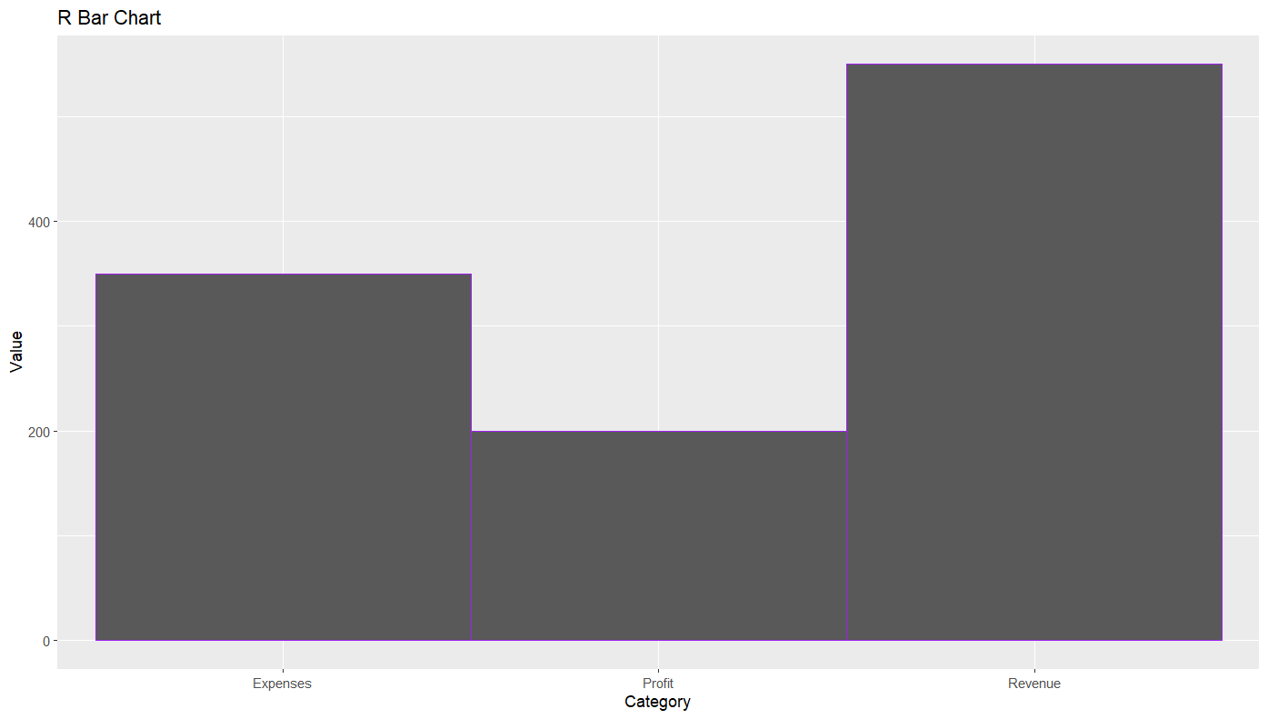
R bar chart
ggplot(data, aes(x = Category, y = Actual)) + geom_bar(stat="identity", width=1, color="purple")+ labs(title = "R Bar Chart", x = "Category", y = "Value")

